Slide 1

Define mitosis and meiosis and identify what occurs at each phase of cell division
Compare and contrast mitosis and meiosis
© Kesler Science, 2016

Slide 2
DEFINE mitosis and meiosis and IDENTIFY what occurs at each phase of cell division
COMPARE and CONTRAST mitosis and meiosis
© Kesler Science, 2016

Slide 3
I CAN define mitosis and meiosis and identify what occurs at each phase of cell division
I CAN compare and contrast mitosis and meiosis
© Kesler Science, 2016

Slide 4

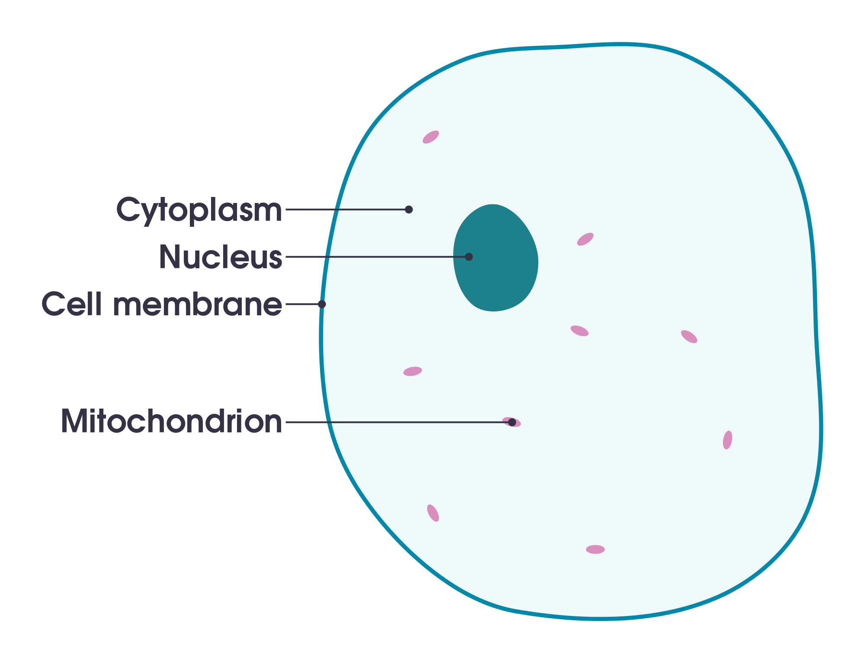
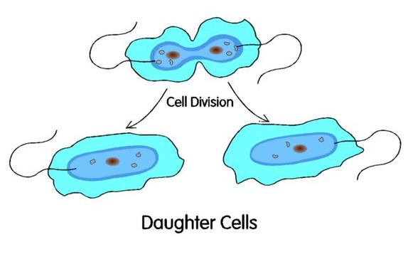
Cells
Cell Division
© KeslerScience.com2016

Slide 5
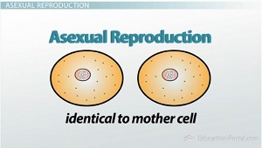
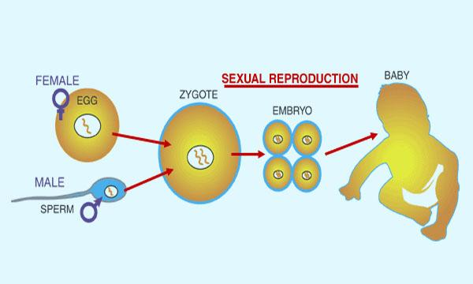
Asexual
Reproduction
Sexual
Reproduction
© KeslerScience.com2016

Slide 6
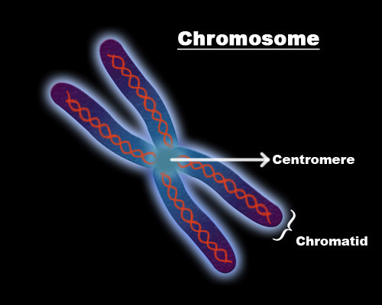
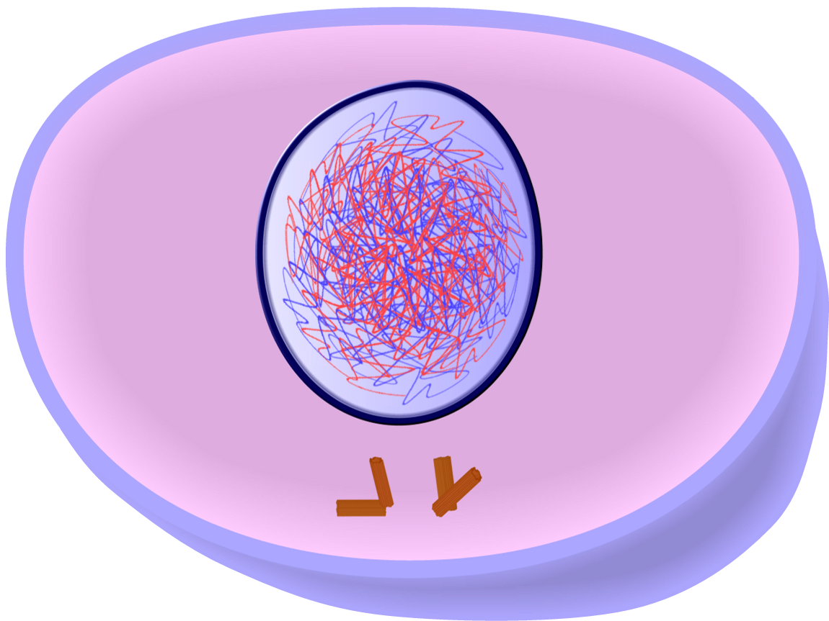
Chromosomes
Chromatin
© KeslerScience.com2016

Slide 7
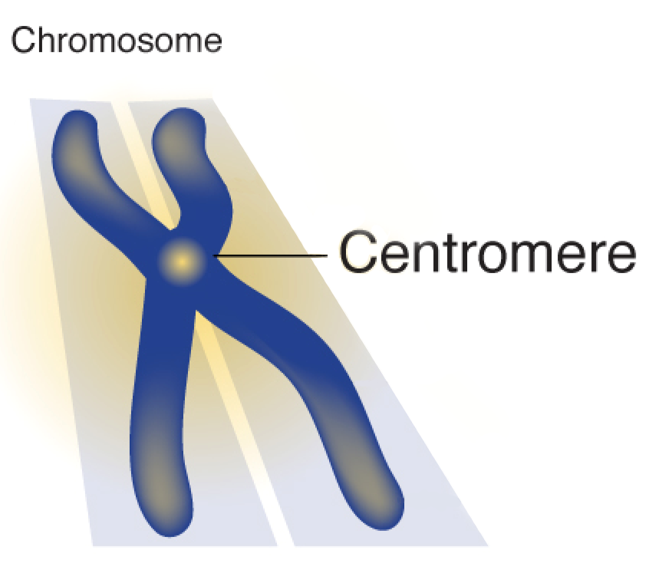
Daughter
Cells
Centromere
© KeslerScience.com2016

Slide 8
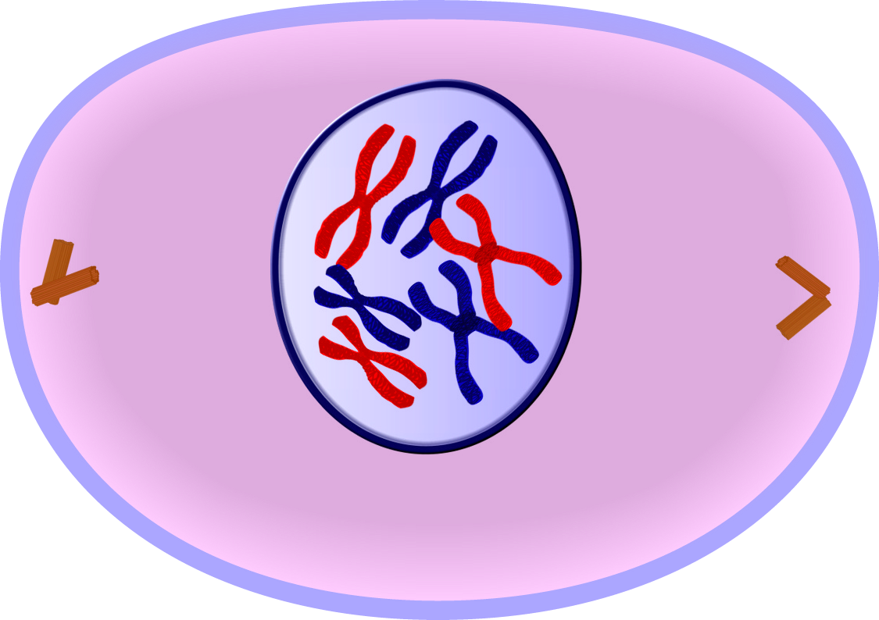
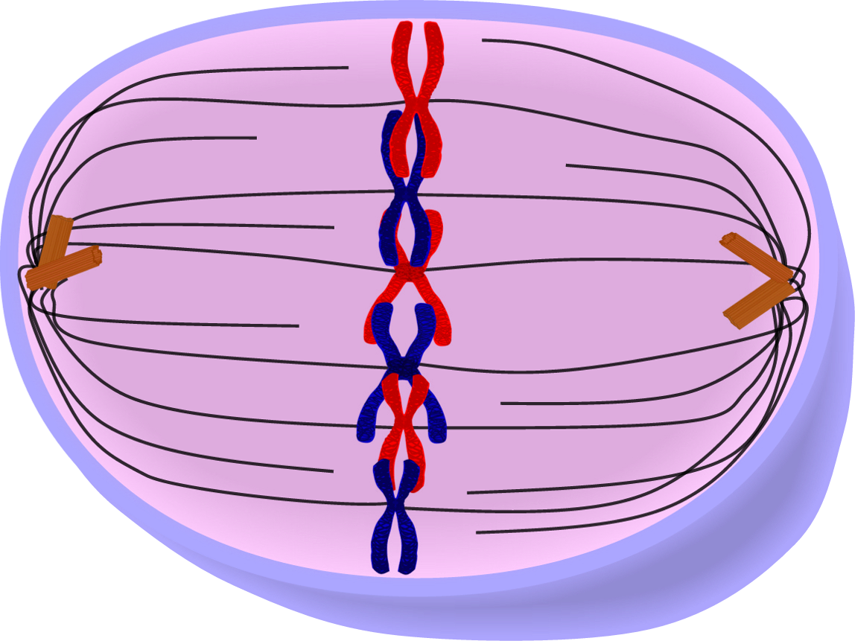
Prophase
(Mitosis)
Metaphase
(Mitosis)
© KeslerScience.com2016

Slide 9
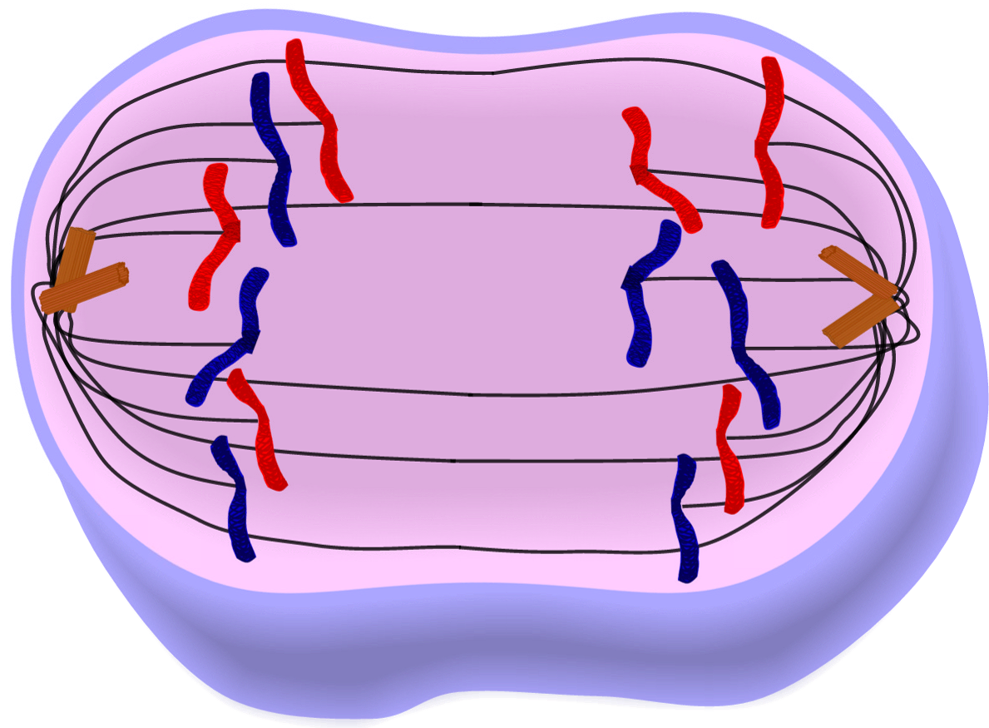
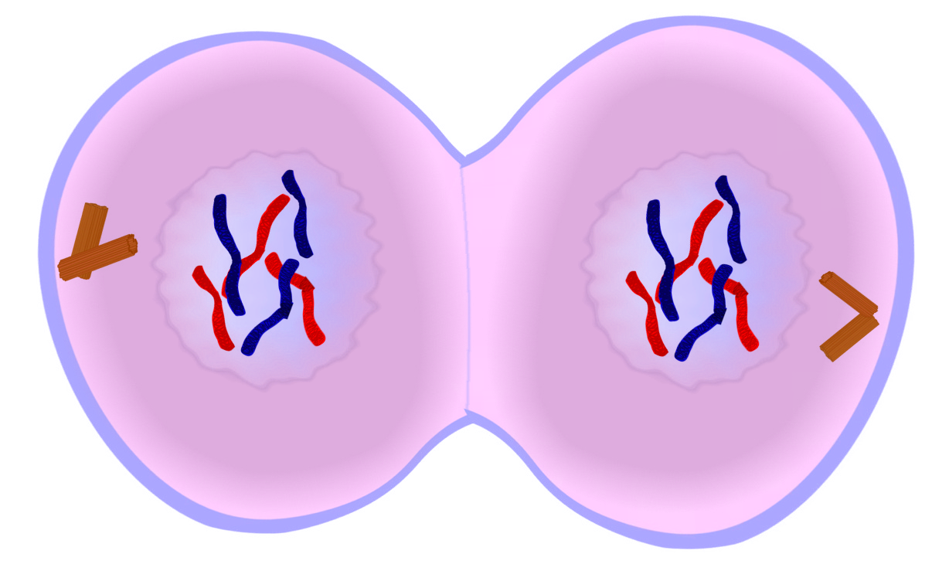
Anaphase
(Mitosis)
Telophase
(Mitosis)
© KeslerScience.com2016

Slide 10
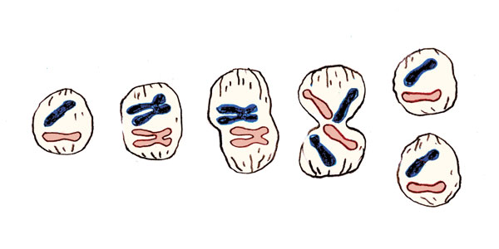
Interphase
(Mitosis)
Mitosis
© KeslerScience.com2016

Slide 11
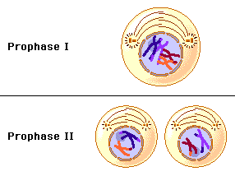
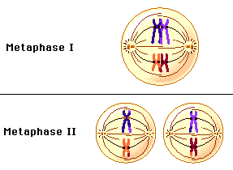
Prophase I & ll
(Meiosis)
Metaphase I & ll
(Meiosis)
© KeslerScience.com2016

Slide 12
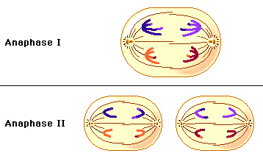
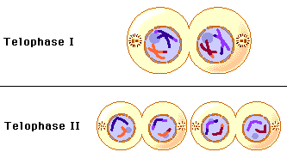
Anaphase I & ll
(Meiosis)
Telophase I & ll
(Meiosis)
© KeslerScience.com2016

Slide 13
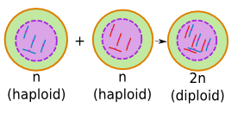
Diploid Cells
Haploid Cells
© KeslerScience.com2016

Slide 14
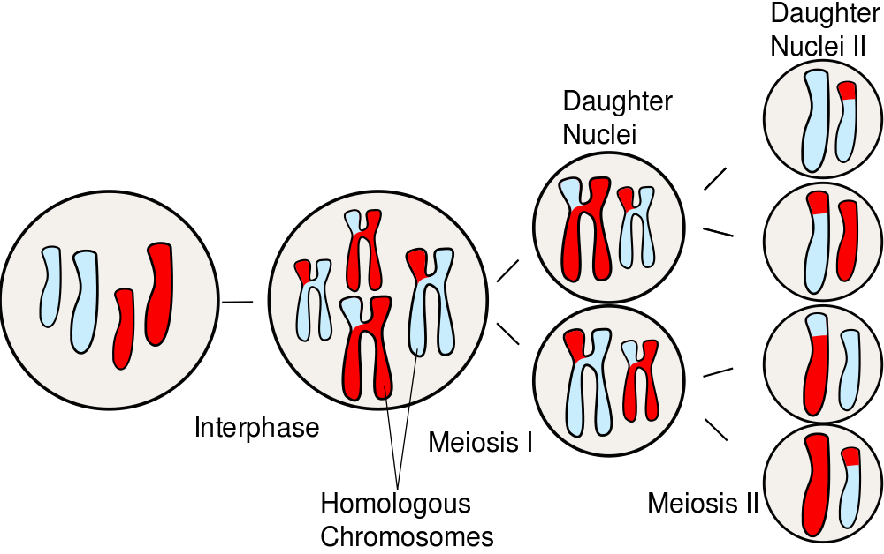
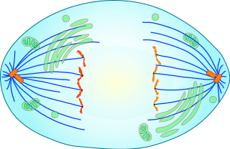
Meiosis
Centriole
© KeslerScience.com2016

Slide 15
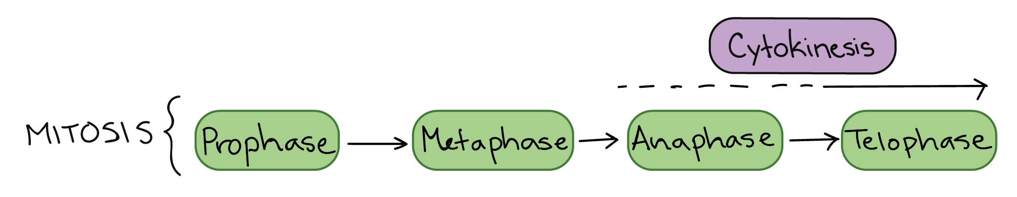
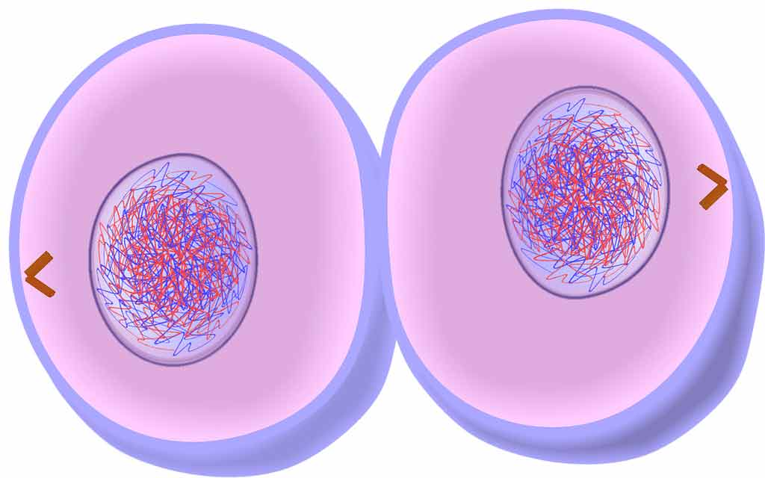
Cell Cycle
Cytokinesis
© KeslerScience.com2016

Slide 16
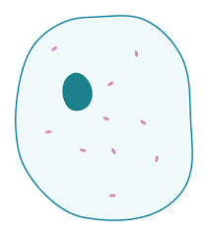
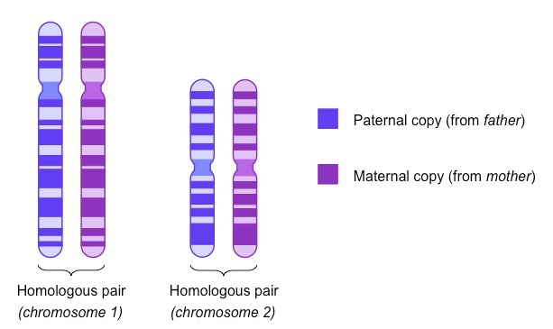
Interkinesis
(Meiosis)
Homologous
Chromosomes
© KeslerScience.com2016

Slide 17

Replicate
Spindle
Fibers
© KeslerScience.com2016

Slide 18
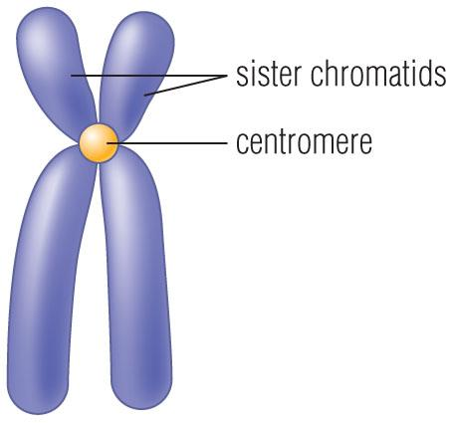
Sister
Chromatids
Nuclear
Envelope
© KeslerScience.com2016

Slide 19
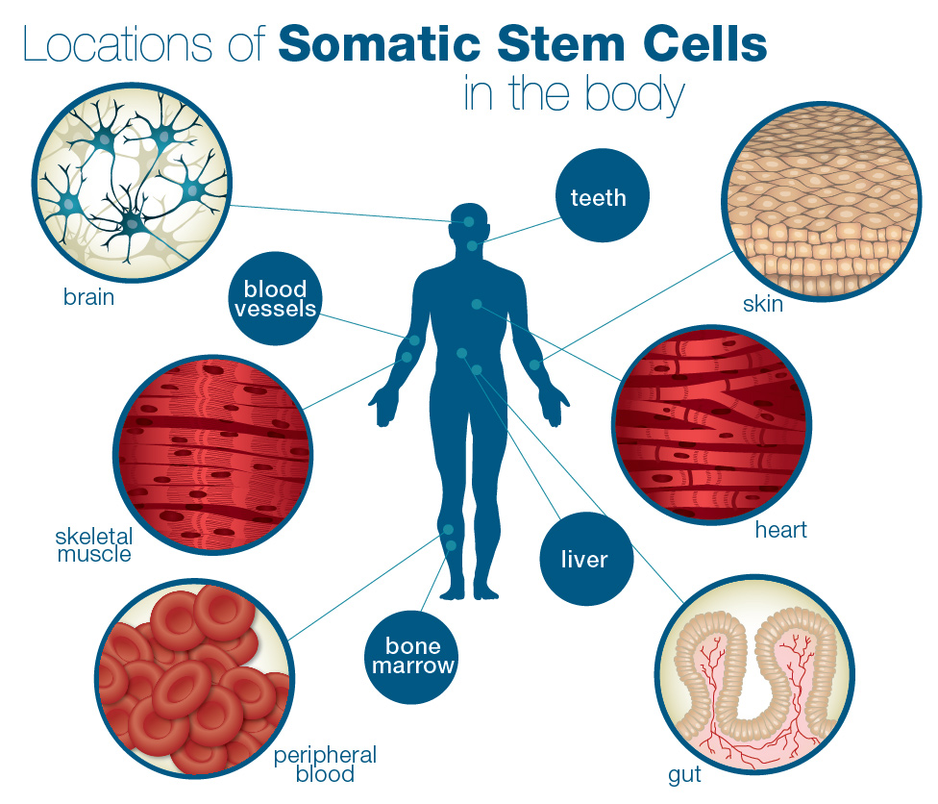

Somatic
Cell
Germ Cell
© KeslerScience.com2016

Slide 20
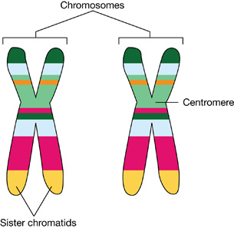
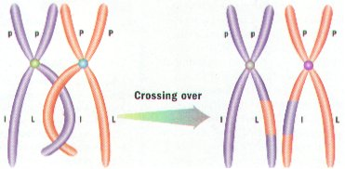
Homologous
Chromosomes
Crossing
Over
© KeslerScience.com2016

Slide 21
Centrosome
© KeslerScience.com2016

Slide 22
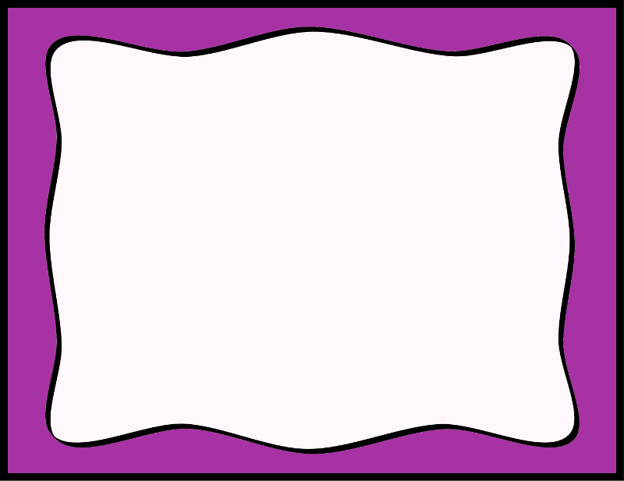
Cells
Cell Division
© KeslerScience.com2016

Slide 23
Asexual
Reproduction
Sexual
Reproduction
© KeslerScience.com2016

Slide 24
Chromosomes
Chromatin
© KeslerScience.com2016

Slide 25
Daughter
Cells
Centromere
© KeslerScience.com2016

Slide 26
Prophase
(Mitosis)
Metaphase
(Mitosis)
© KeslerScience.com2016

Slide 27
Anaphase
(Mitosis)
Telophase
(Mitosis)
© KeslerScience.com2016

Slide 28
Interphase
(Mitosis)
Mitosis
© KeslerScience.com2016

Slide 29
Prophase I & ll
(Meiosis)
Metaphase I & ll
(Meiosis)
© KeslerScience.com2016

Slide 30
Anaphase I & ll
(Meiosis)
Telophase I & ll
(Meiosis)
© KeslerScience.com2016

Slide 31
Diploid Cells
Haploid Cells
© KeslerScience.com2016

Slide 32
Meiosis
Centriole
© KeslerScience.com2016

Slide 33
Cell Cycle
Cytokinesis
© KeslerScience.com2016

Slide 34
Interkinesis
(Meiosis)
Homologous
Chromosomes
© KeslerScience.com2016

Slide 35
Replicate
Spindle
Fibers
© KeslerScience.com2016

Slide 36
Sister
Chromatids
Nuclear
Envelope
© KeslerScience.com2016

Slide 37
Somatic
Cell
Germ Cell
© KeslerScience.com2016

Slide 38
Centrosome
© KeslerScience.com2016

